Slide 1
> set-speaker “Joe Brinkman”
> set-session “Take Command Of DNN”

Slide 2

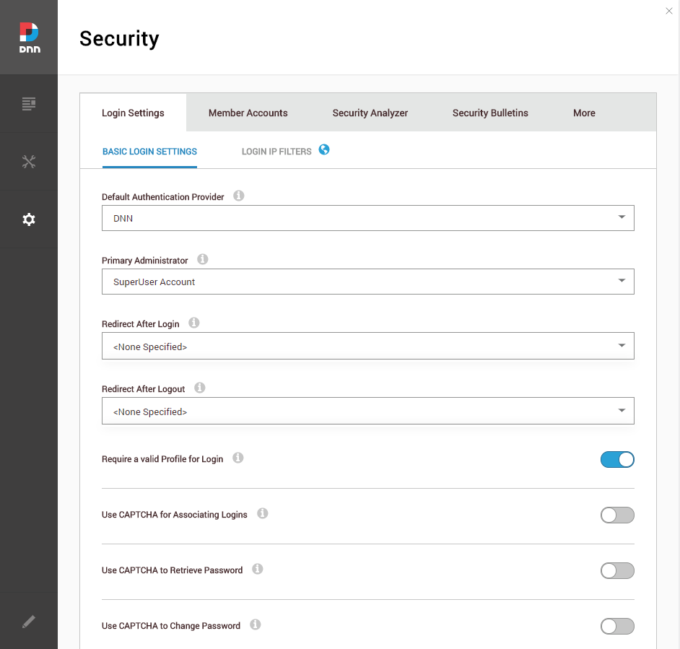
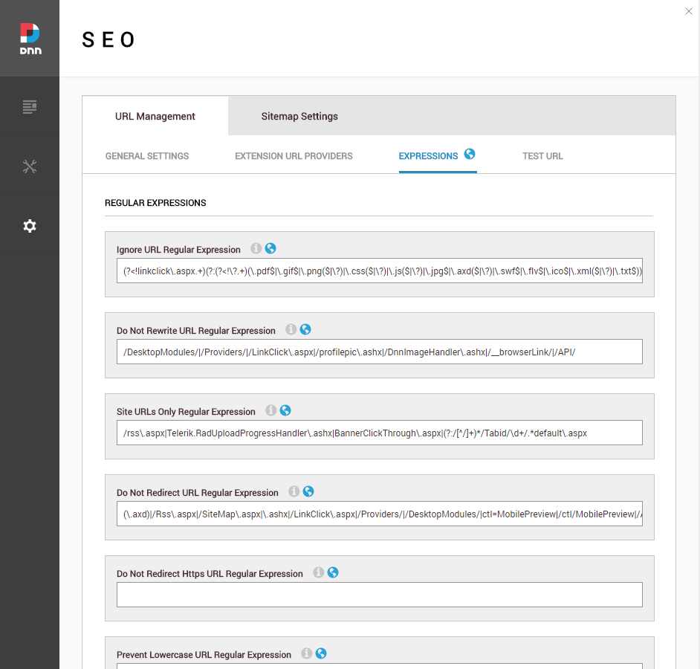
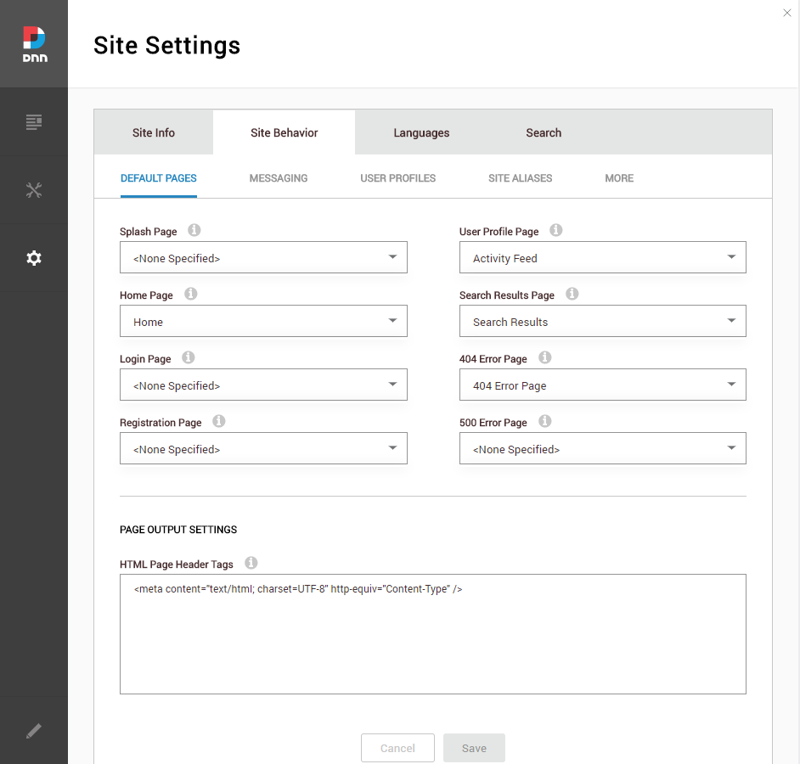
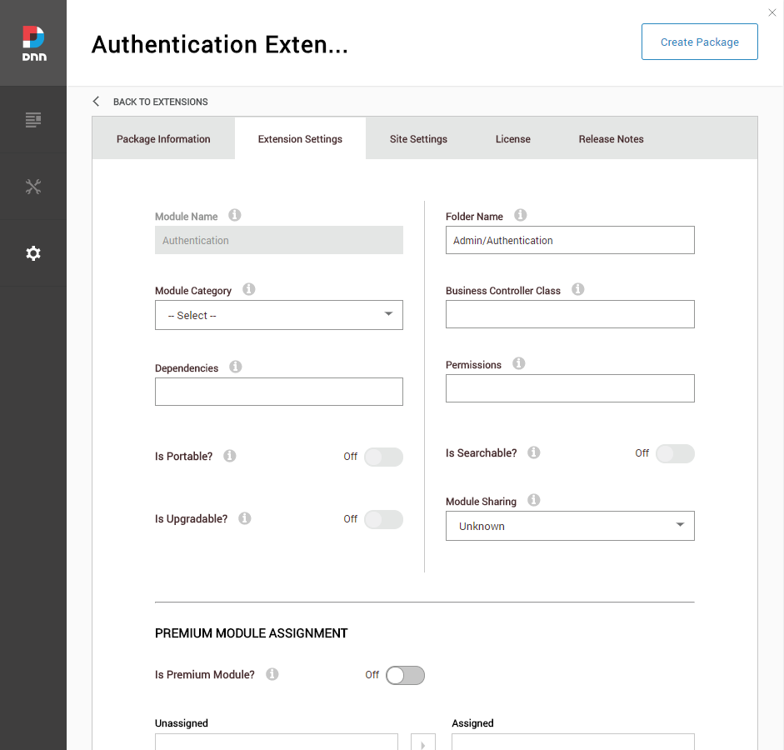
> Set-Problem –UIComplexity 100
Security - Photos
SEO - Photos
Site Settings - Photos
Extensions - Photos

Slide 3
> Set-Problem –Obscurity 100
Email on Portal Alias Change?
Disable the Biography field?
Allow a site to use a module?

Slide 4
> Set-Problem –Speed Slow
Navigation – panels, tabs, sections
Multi-click workflows

Slide 5
> Set-Problem -Automation manual
Not Repeatable
Not Scriptable

Slide 6
> Get-Help “DNN Prompt”
Command Service is Key
Web Console OOTB
PowerShell FTW
Web Console
PowerShell
Your App?
Command Service

Slide 7
> Get-Help “Web Console”
Full Command List
Integrated Help
Linked Resources

Slide 8
>
██████╗ ███████╗ ███╗ ███╗ ██████╗ ██╔══██╗ ██╔════╝ ████╗ ████║ ██╔═══██╗ ██║ ██║ █████╗ ██╔████╔██║ ██║ ██║ ██║ ██║ ██╔══╝ ██║╚██╔╝██║ ██║ ██║ ██████╔╝ ███████╗ ██║ ╚═╝ ██║ ╚██████╔╝ ╚═════╝ ╚══════╝ ╚═╝ ╚═╝ ╚═════╝
Notes:
Basic console demo

Slide 9
> Get-Help “Prompt Integration”
PowerShell
Mobile
[Your App Here]

Slide 10
>
██████╗ ███████╗ ███╗ ███╗ ██████╗ ██╔══██╗ ██╔════╝ ████╗ ████║ ██╔═══██╗ ██║ ██║ █████╗ ██╔████╔██║ ██║ ██║ ██║ ██║ ██╔══╝ ██║╚██╔╝██║ ██║ ██║ ██████╔╝ ███████╗ ██║ ╚═╝ ██║ ╚██████╔╝ ╚═════╝ ╚══════╝ ╚═╝ ╚═╝ ╚═════╝
Notes:
Create custom command

Slide 11

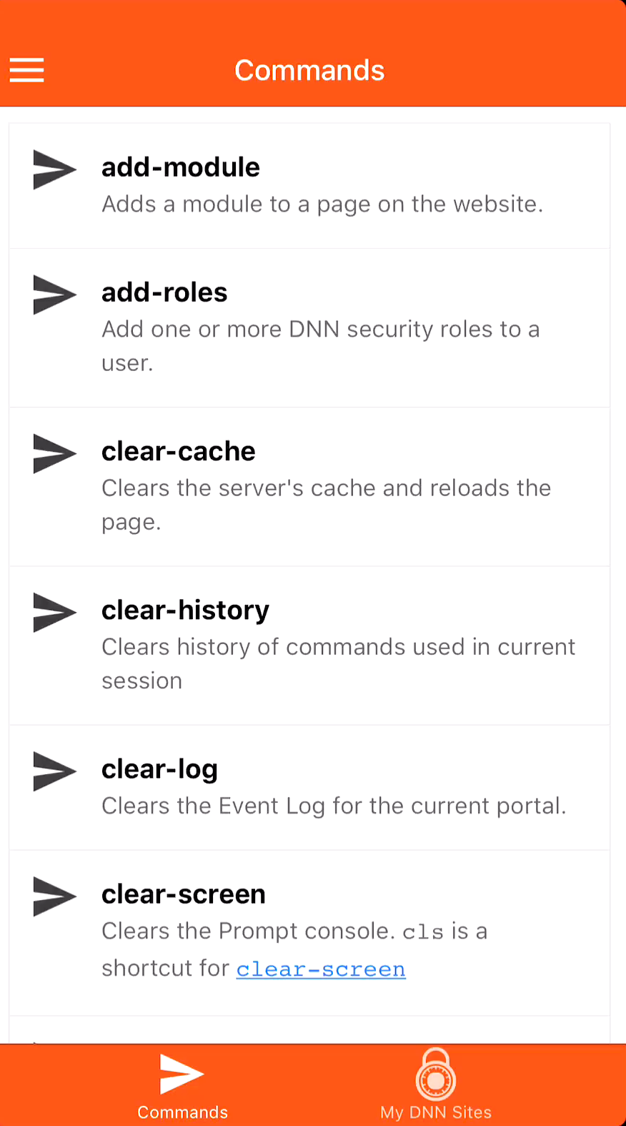

Slide 12
> Get-Help “Command Service”
Extensible
Accessible
Secure

Slide 13
>
██████╗ ███████╗ ███╗ ███╗ ██████╗ ██╔══██╗ ██╔════╝ ████╗ ████║ ██╔═══██╗ ██║ ██║ █████╗ ██╔████╔██║ ██║ ██║ ██║ ██║ ██╔══╝ ██║╚██╔╝██║ ██║ ██║ ██████╔╝ ███████╗ ██║ ╚═╝ ██║ ╚██████╔╝ ╚═════╝ ╚══════╝ ╚═╝ ╚═╝ ╚═════╝
Notes:
PowerShell script
Mobile App

Slide 14
> Set-Status -WorkInProgress
Initial Framework Complete
Needs more testing
Needs more commands
Needs

Slide 15
> Get-Resources
https://github.com/dnnsoftware/Dnn.AdminExperience.Extensions
https://github.com/DNN-Connect/Dnn-Powershell
https://github.com/dnnsoftware/Dnn.Platform.Samples

Slide 16

> Sponsors

Slide 17
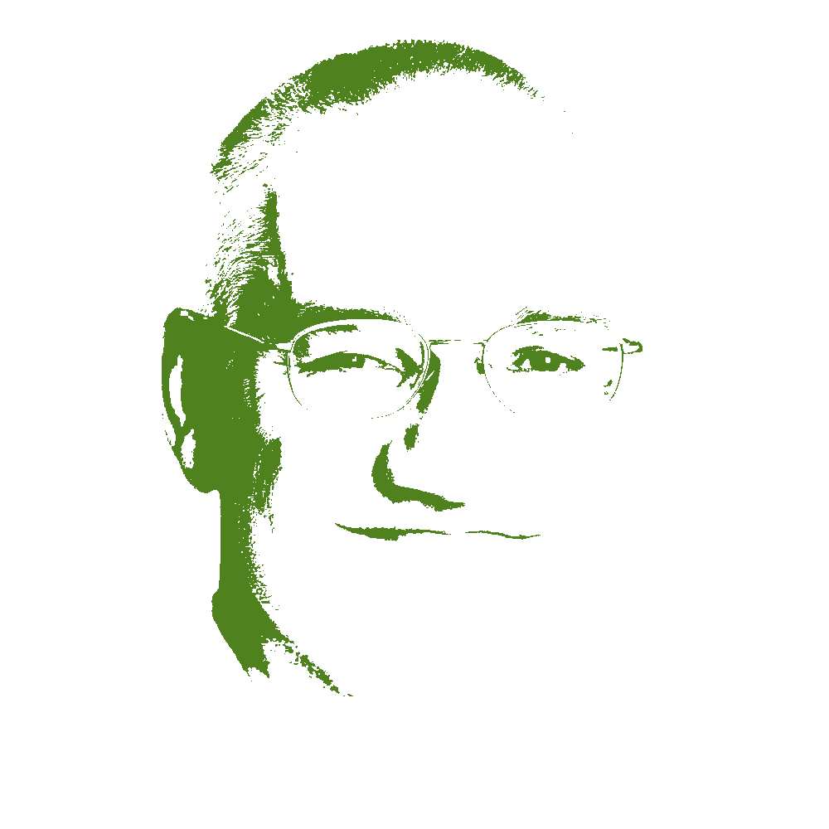




> About Me
joe@brinkman.me
jbrinkman
http://github.com/jbrinkman
https://www.linkedin.com/in/joebrinkman/
This Photo by Unknown Author is licensed under CC BY-SA

